Slide 1

LA French Tech Beyrouth
Presentation
There’s never been a better time to join, found or invest in a startup in France. We have built a branch website for La French Tech and is looking for talents from all over the world to join the adventure.

Slide 2





Demo
Processes
About French Tech
Challenges

Slide 3

About French Tech
*Some Clarifications*
What is « La French Tech »?
Her mission ?
How France helps Startups ?
French Tech Beyrouth ?

Slide 4
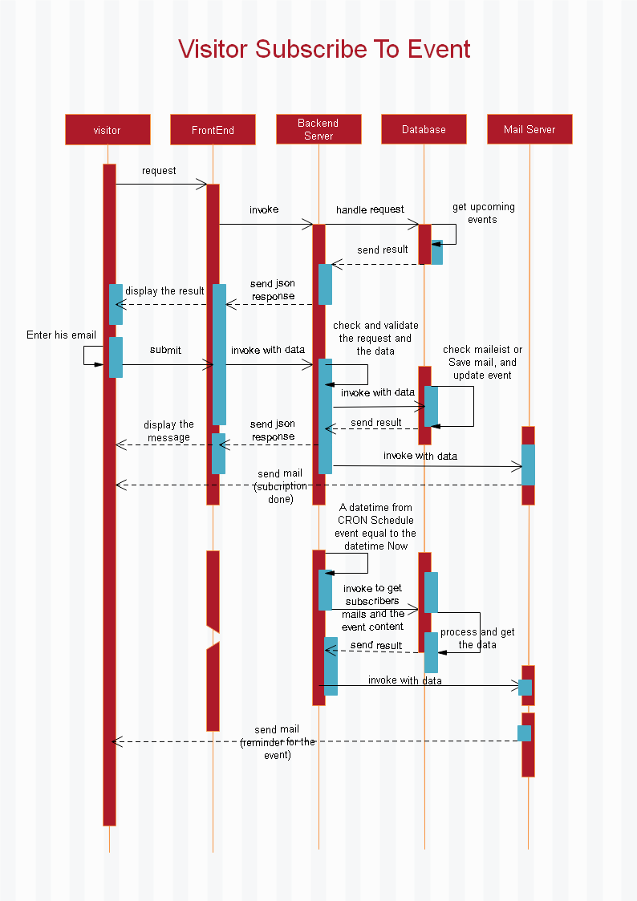
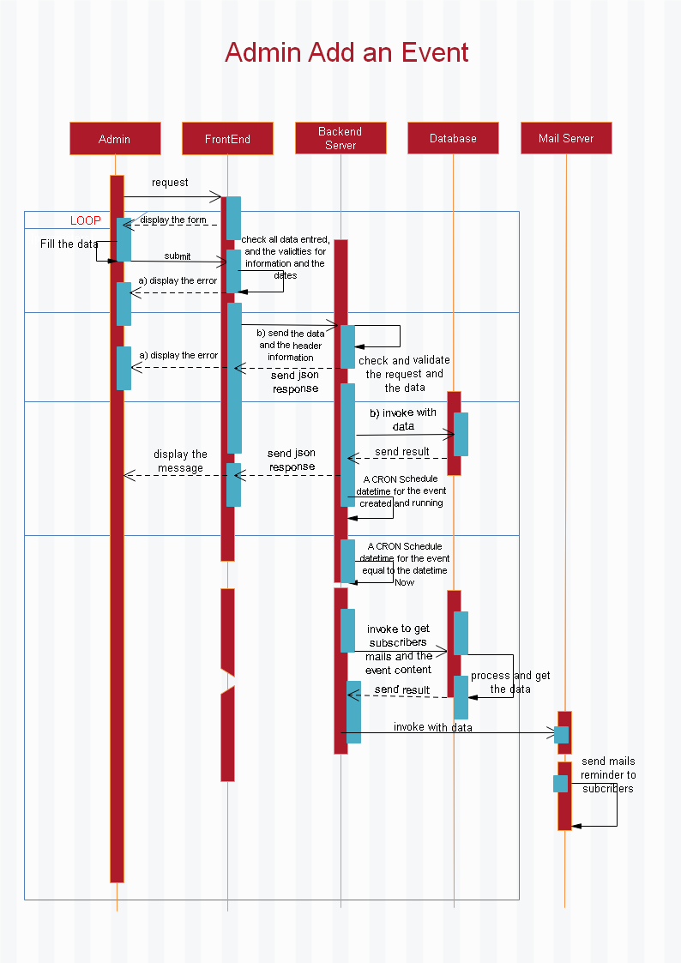
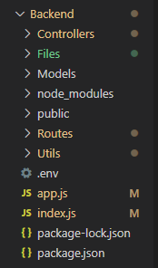
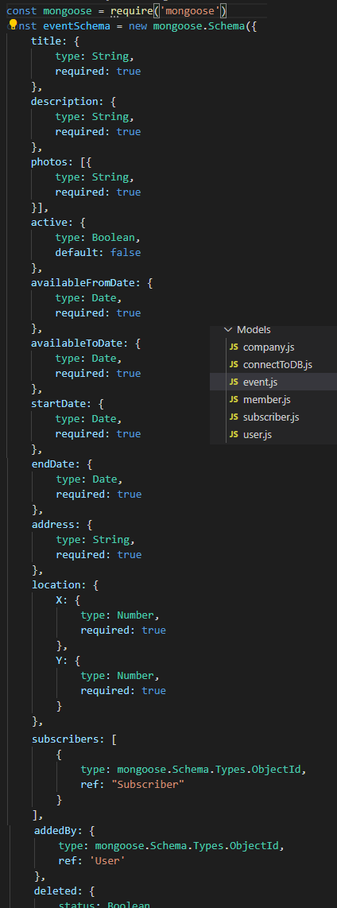
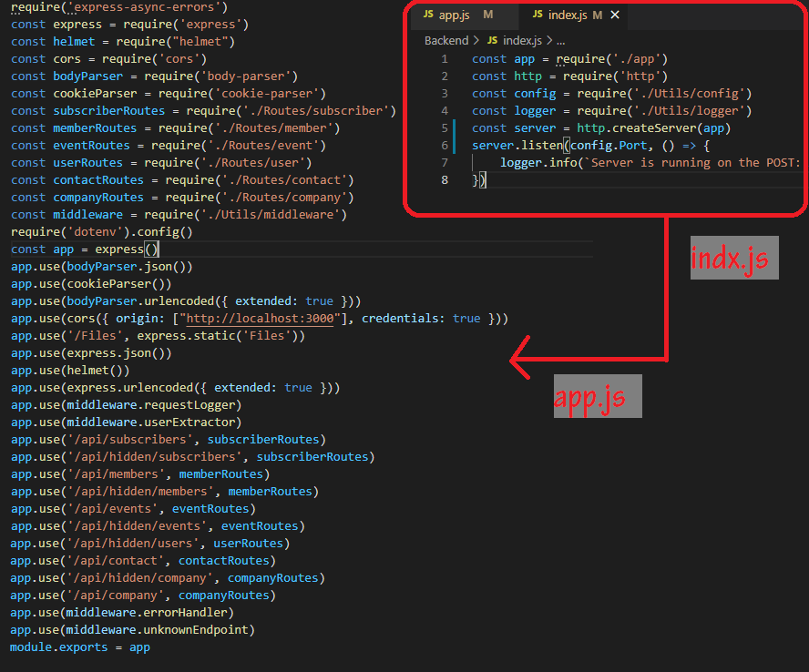
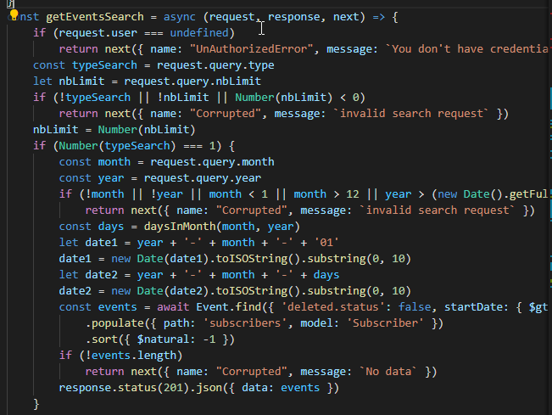
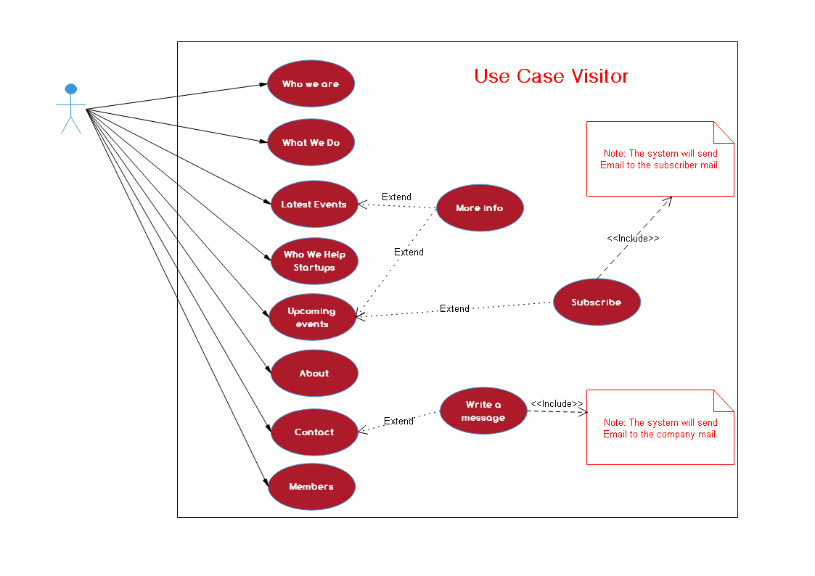
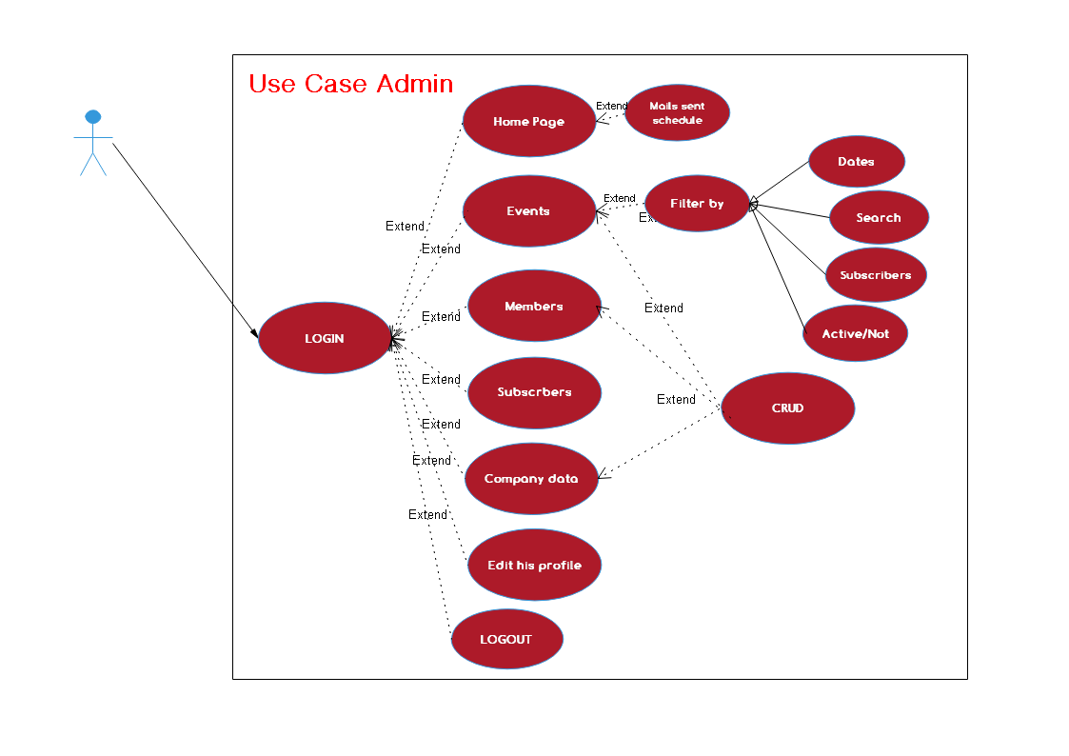
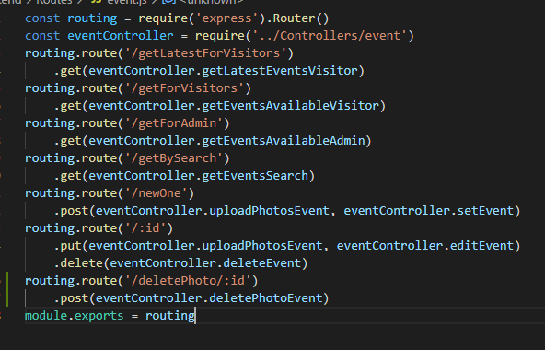
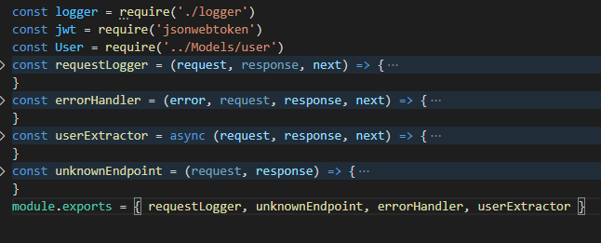
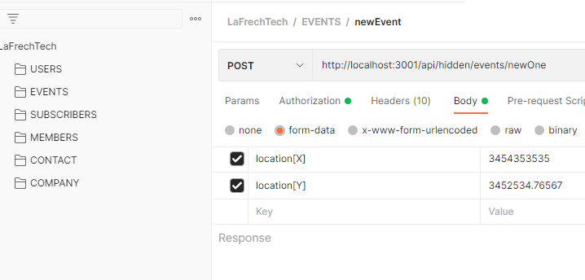
Process - Backend
1. Uml Diagram
Use case visitors
Use case admin
One sequence for visitor
One sequence for admin
2. Create Server
Http server
Middleware
3. Data base
Schemas
Controllers
Routing
4. Hierarchy
5. Testing
Postman

Slide 5
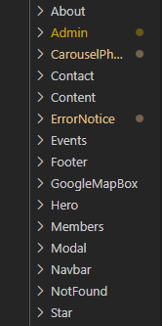
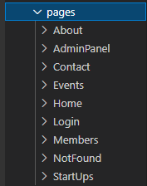
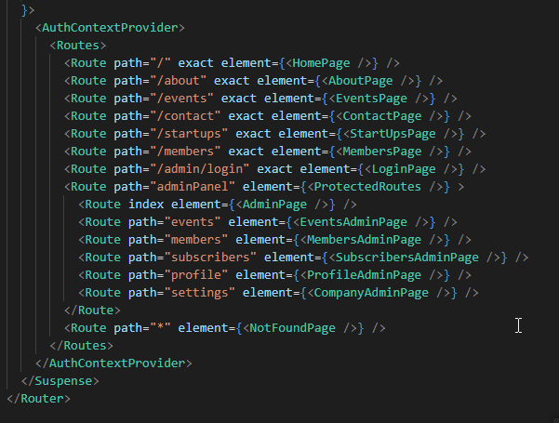
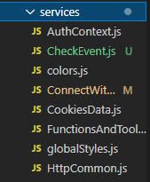
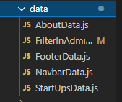
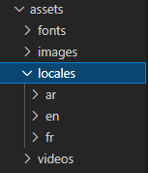
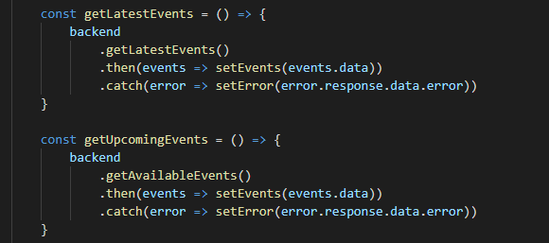
Process - Frontend
1. Set up the first step in front end
Create the react app
Install initial modules
Build the routes
2. Sketching the website
3. Create the pages
4. Create the components
5. Set up the static data for components
6. Set up the translation text
7. Set up the services data
8. Testing

Slide 6
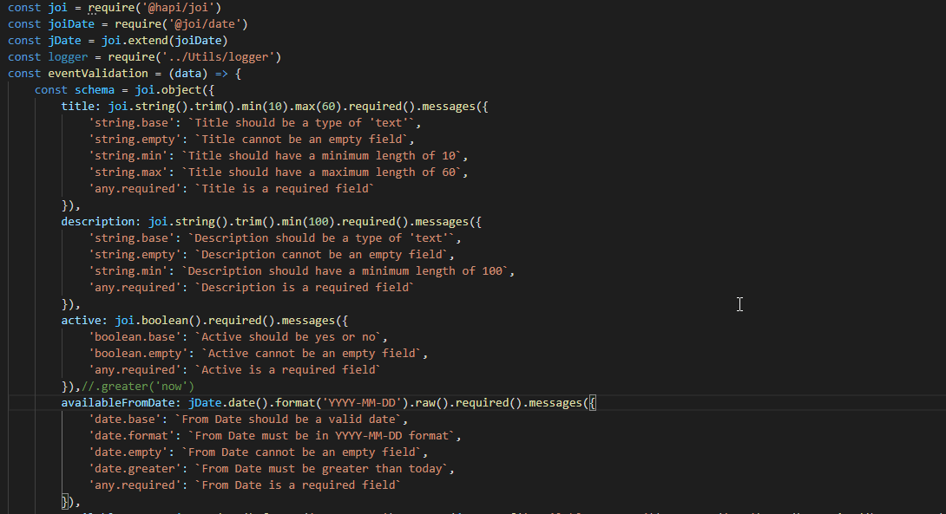
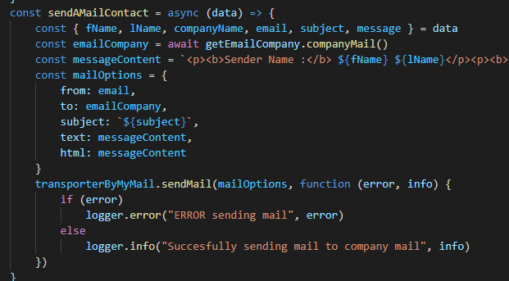
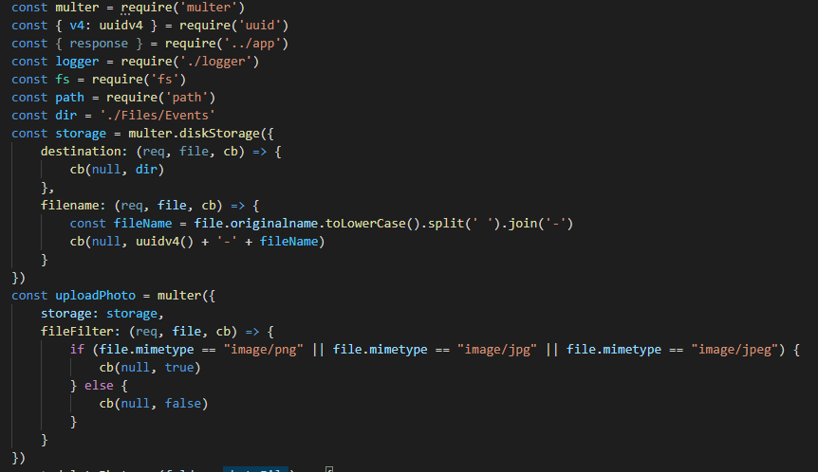
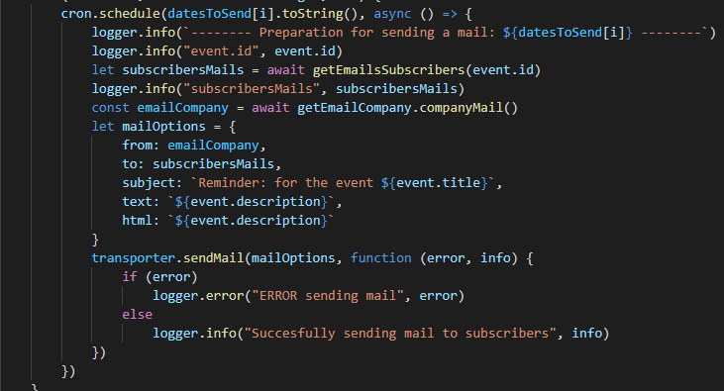
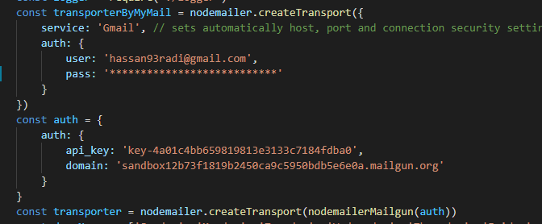
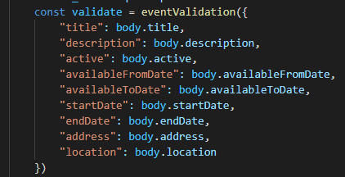
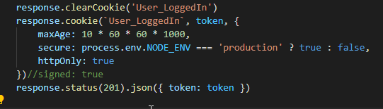
Process - Modules
Back end packages:
@hapi/joi - @joi/date:
bcrypt:
body-parser
cookie-parser
cors
dotenv
express
express-async-errors
file-system
helmet
jsonwebtoken
moment-timezone
multer
node-cron
nodemailer
nodemailer-mailgun-transport:
Uuid

Slide 7
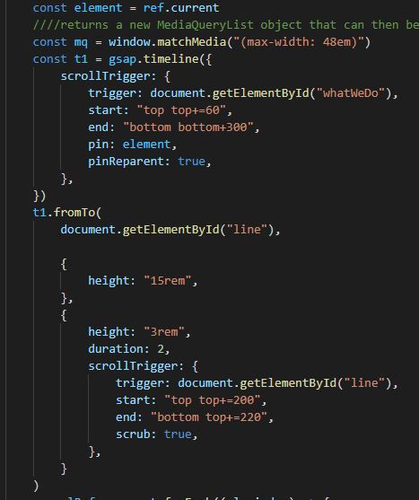
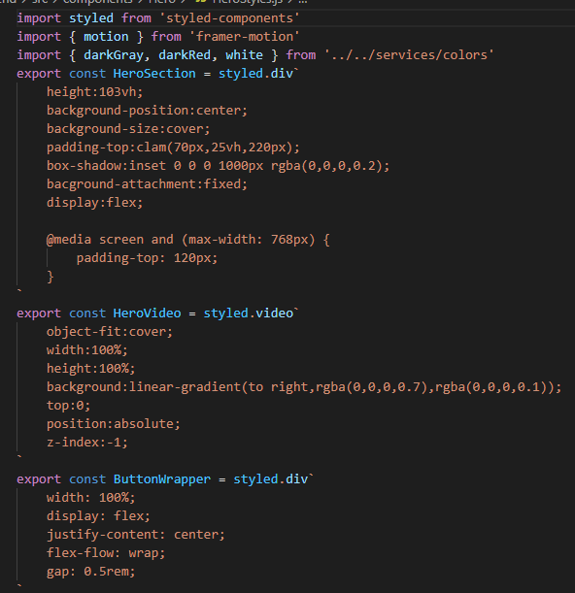
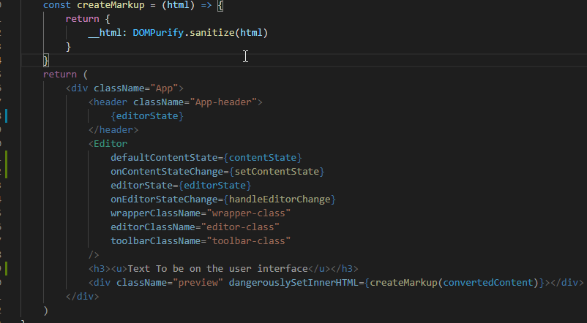
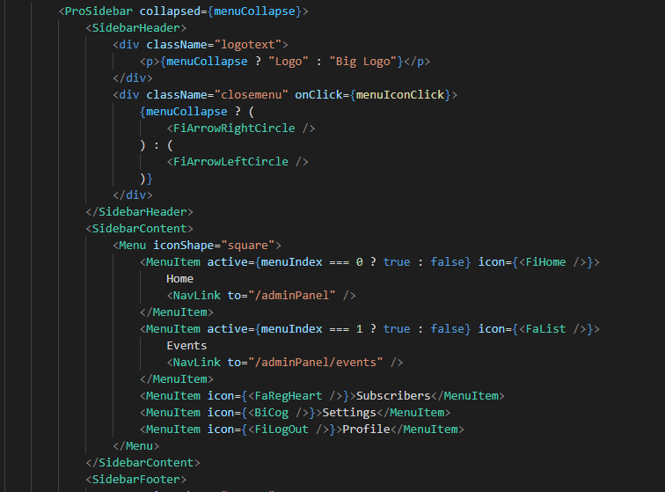
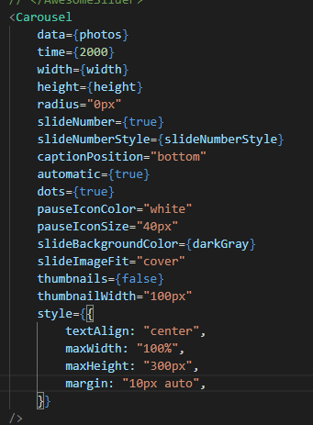
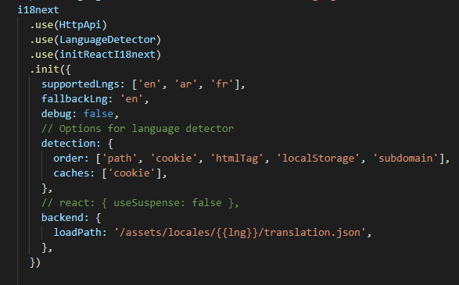
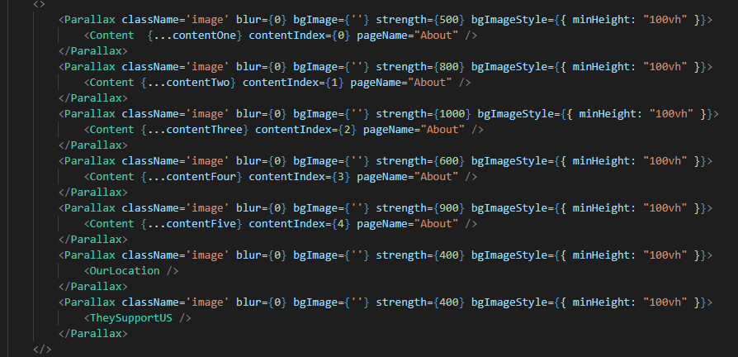
Process - Modules
Front end package:
dompurify:
draft-js:
flag-icons:
framer-motion:
gsap:
i18next:
js-cookie:
react-awesome-slider:
react-icons:
react-intersection-observer:
react-parallax:
react-player:
react-pro-sidebar:
react-router-dom:
react-scroll:
styled-components: @hapi/joi

Slide 8

Challenges
1) Translation
How to translate headers, text, arrays, objects, and dates.
2) Mails
Send mails across static transporter, or platform transporter.
3) Text Editor
Best editor for allowing write and format a text.
4) Styled Component
The place for write CSS in your JavaScript
5) Heroku
Heroku is a cloud platform as a service supporting several programming languages.

Slide 9

Duration of the work
Backend:
7 days with 14 cup of coffee.
Frontend
14 days with 45 cup of coffee and 5 pieces Panadol.
Testing and Uploading
2 days and 2 Nescafe cup.

Slide 10

Demo:
Now we can see and interact with the site.

Slide 11
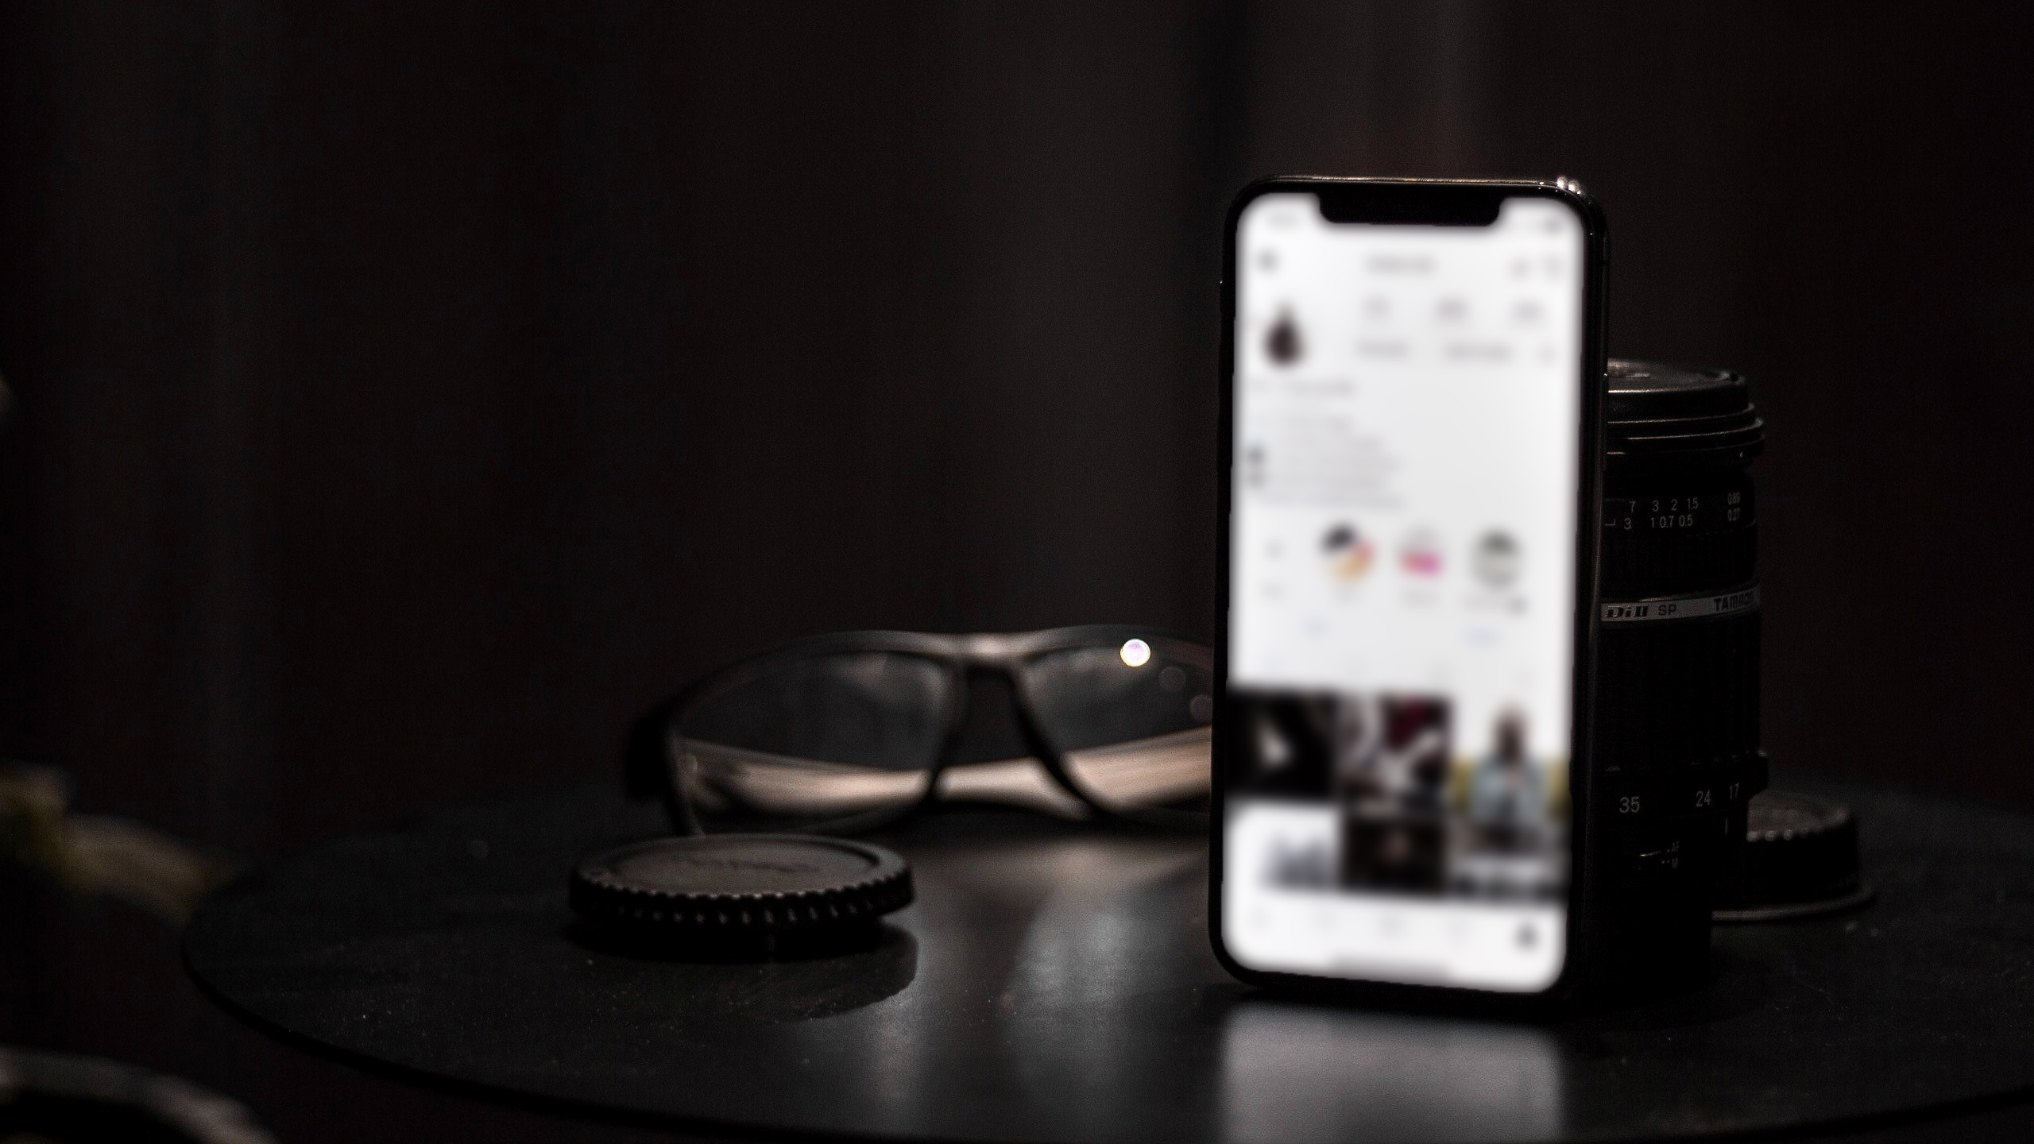
T h a n k Y o u
FOR YOUR ATTENTION

